Slide 1
Loan default/fraud prediction
Using machine learning

Slide 2
objective
Many customers of banks become defaulters and some persons refused to pay loan amount even thought he/she can.
This causes financial losses to bank and create difficulties to repay or pay the amount or interest of depositors and investors which financial lose to them. It create black mark to bank and bank mangers
To avoid this scenarios, our aim to develop a machine learning model to predict defaulters of loan using machine learning algorithms

Slide 3
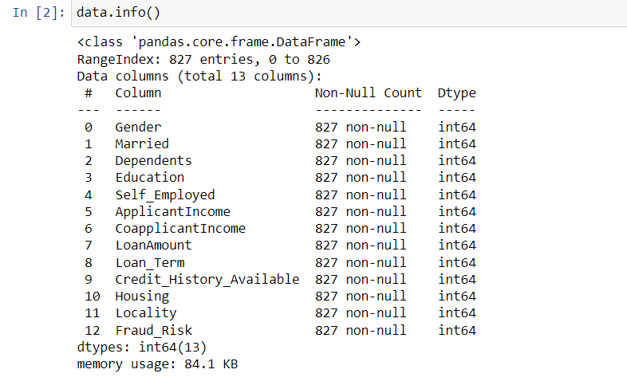
Dataset
Mentor provided dataset is used to develop the machine learning model
Above are the information about given dataset

Slide 4
Data preprocessing/cleaning
Checked for null values , no null values is detected
Detected duplicated records and dropped it
Checked outliers by data visualization
Not much outliers was detected and detected outliers are removed by inter quantile rule

Slide 5
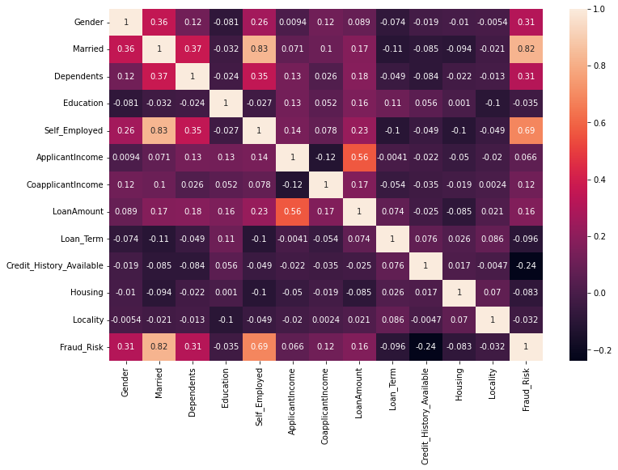
Co-relation matrix

Slide 6
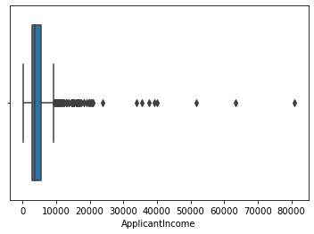
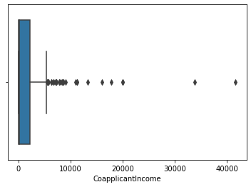
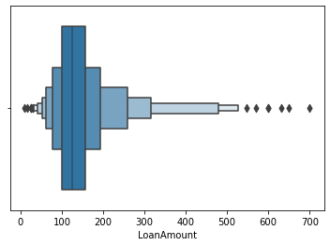
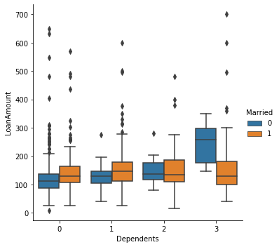
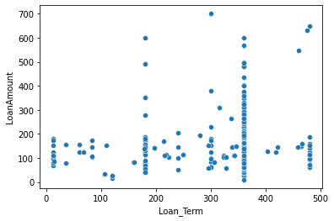
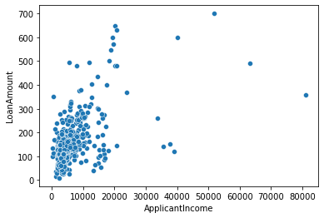
Data visualization

Slide 7
Model building
Split into dependent and independent features
Then dataset is split into train and test datasets
Linear Regression , Lasso, Ridge, KNN, Random Forest, Decision Tree, SVM models are used for prediction

Slide 8
Accuracy of models
At last accuracy given by models are
Logistic Regression:65.21739130434783 %
SVM:60.86956521739131 %
Decision Tree :90.57971014492754 %
Random Forest :95.65217391304348 %
KNneighbors :67.39130434782609 %
Conclusion
Random Forest gives high accuracy than other models

Slide 9
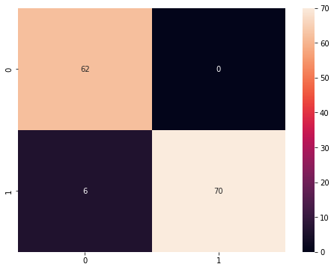
Confusion Matrix

